Slide 1

Stress Relief
A cloud-based machine learning tool to ease stress in identifying stress resistant bean genotypes

Slide 2
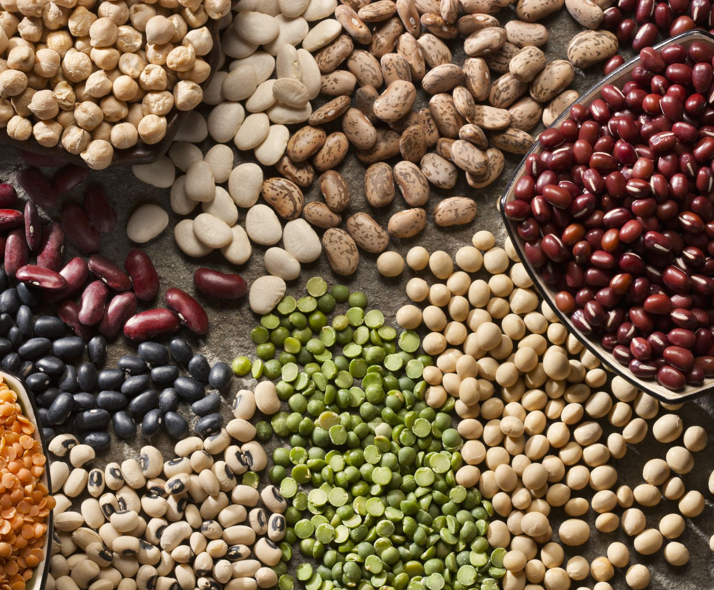
Objective
Identify stress-resistant genotypes within each bean panel.

Slide 3

Motivation
Plant breeders need rapid genotyping solutions
Within ADP and DDP bean panels there are varying resistance levels which can be correlated to crop yield

Slide 4

Workflow
User Input
Azure Machine Learning using CSV files
Output: Best Model
Run Classification Algorithms
Deploy Model
Model Output: Classify Yield
CSV files storage to Azure Blob Container

Slide 5
Algorithm Development
Image Segmentation / Spectral Indices
Training Machine Learning Algorithm
Testing Machine Learning Algorithm

Slide 6
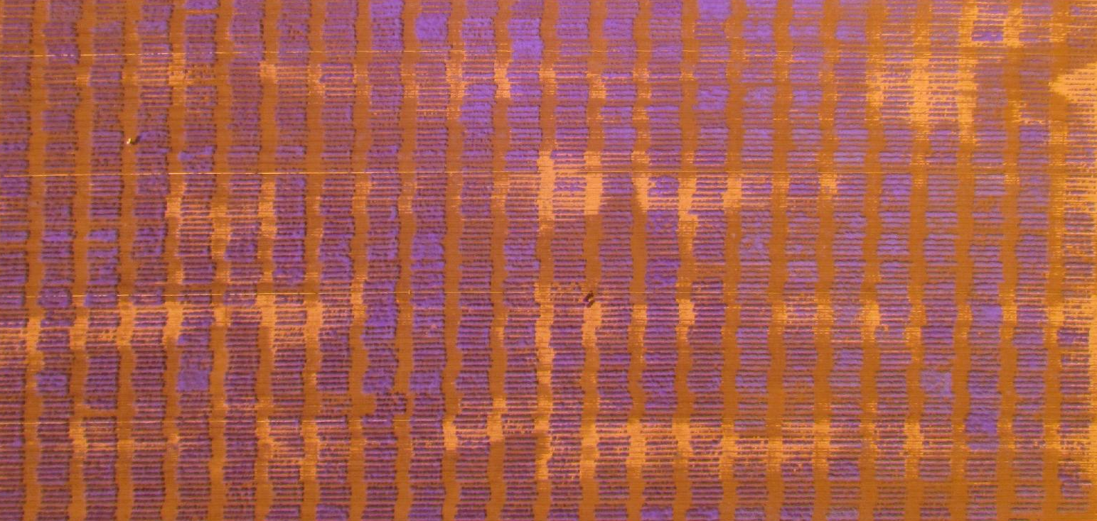
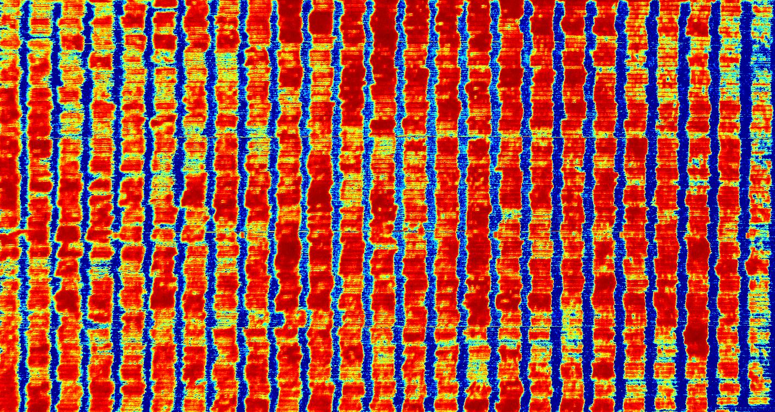
Image Segmentation / Spectral Indices

Slide 7
Vegetation Indices
Green Simple Ratio (GSR)
Normalized Difference Vegetation Index (NDVI)
Renormalized Difference Vegetation Index (RDVI)
Modified Simple Ratio (MSR)
Infrared Percentage Vegetation Index (IPVI)
Non-Linear Index (NLI)
Green Normalized Difference Vegetation Index (GNDVI)
Optimized Soil-Adjusted Vegetation Index (OSAVI)
Green Chlorophyll Index (CIG)
Transformed Difference Vegetation Index (TDVI)
Green Difference Vegetation Index (GDV)
Ratio Vegetation Index (RVI)
Green-Red Vegetation Index(GRVI)
Difference Vegetation Index (DV)
Spectral band: R, G, and NIR

Slide 8
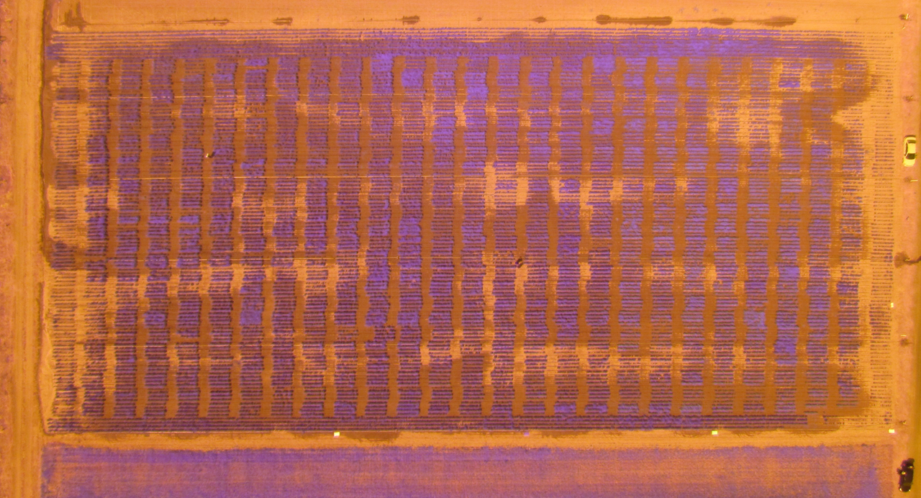
Image Segmentation
Treatment block identification
Treatment block identification
Treatment block
ROI selection
Year 2016
Canopy segmentation
ROI selection
Canopy masking
Genotype ROI identification
VI evaluation

Slide 9
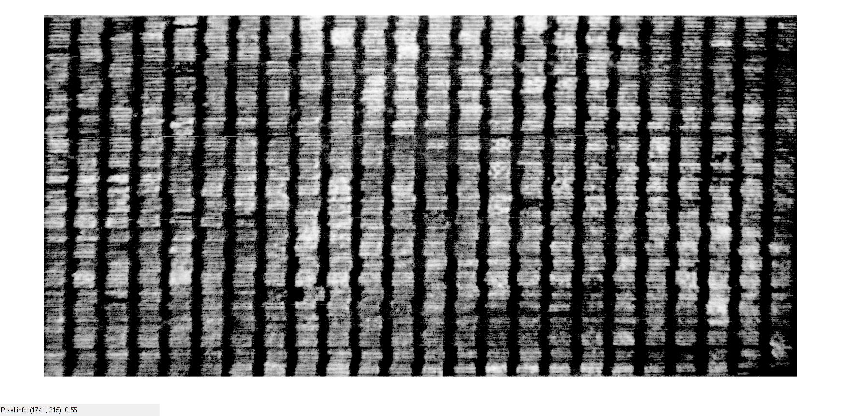
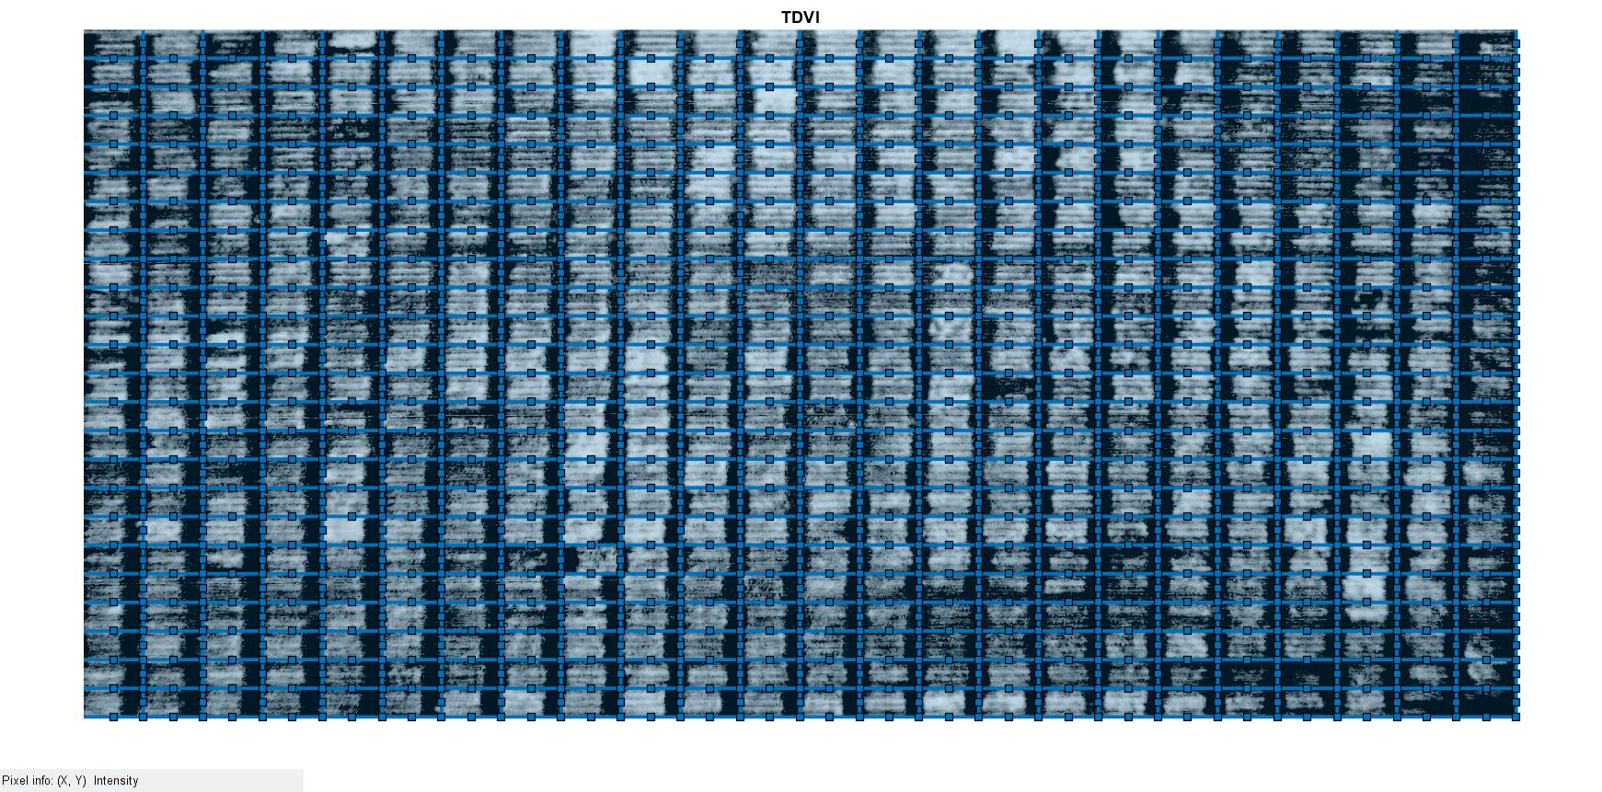
Masked treatments
Image Segmentation
Treatment block identification
ROI selection
Canopy segmentation
Segmented treatment plot
Canopy masking
Genotype ROI identification
Cropped image
VI evaluation

Slide 10
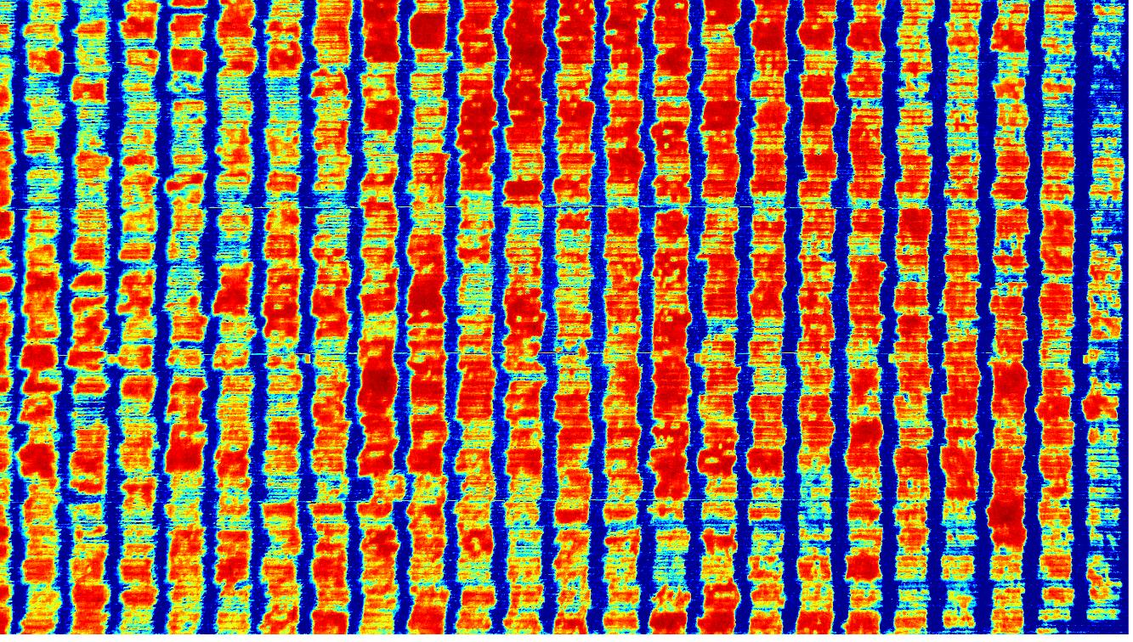
Stress map
VI based stress map
DDP
ADP

Slide 11
Now for a DEMO

Slide 12
Classification Model with Automated ML in Azure
Create and load dataset from Azure Blob Storage
Configure and run experiment
Azure Auto ML generates the best model by running several training algorithms
Deploy Model

Slide 13
Experimental Setup
Validation:
Training Data: 70%
Testing Data: 30%
Primary Performance Metric:
Accuracy
Two separate Models:
ADP
DDP

Slide 14
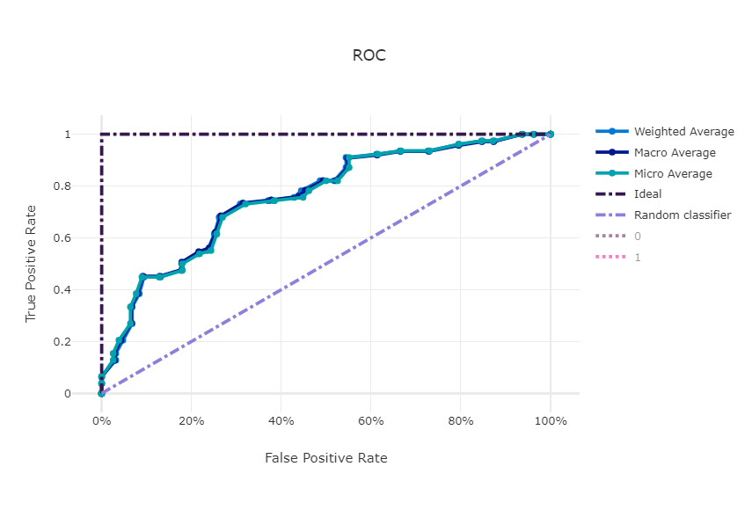
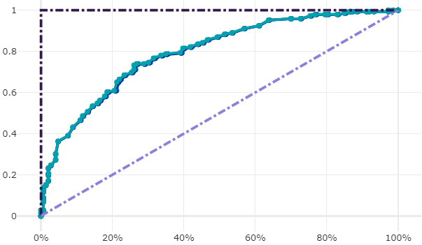
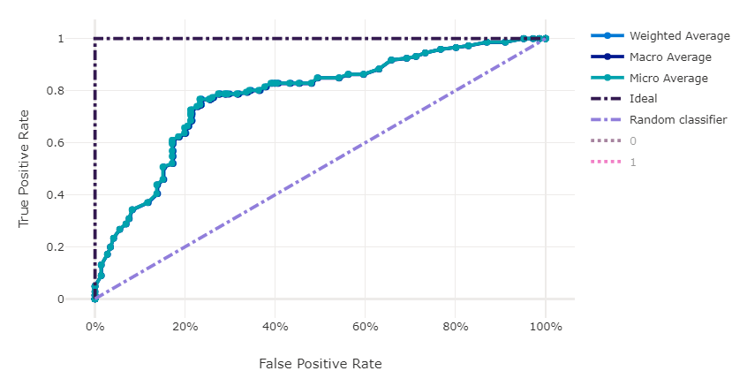
DDP Model 1
Yield prediction Models
DDP Model 1 : 3 Vis
Best Model: Voting Ensemble
Model Accuracy: 74.0%
DDP Model 2 : 14 Vis
DDP Model 2
ADP Model 1 : 3 Vis
ADP Model 2 : 14 Vis
Best Model: Min Max Scaler
Model Accuracy: 76.7%

Slide 15
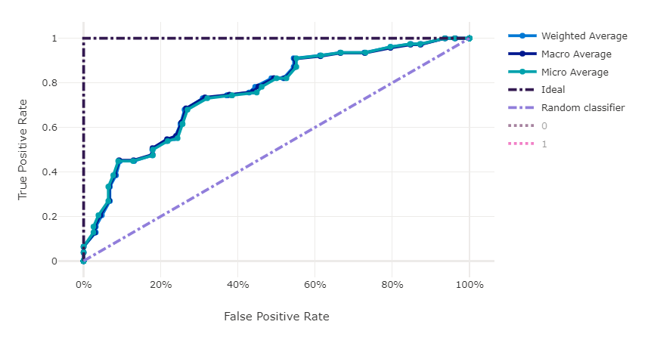
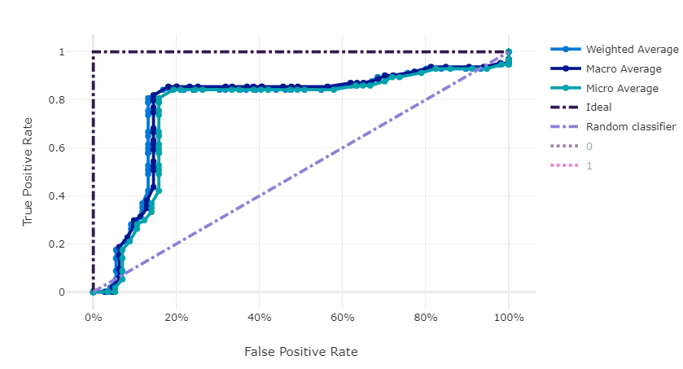
ADP Model 1
Yield prediction Models
DDP Model 1 : 3 Vis
Best Model: Voting Ensemble
Model Accuracy: 73.0%
DDP Model 2 : 14 Vis
ADP Model 2
ADP Model 1 : 3 Vis
Best Model: Voting Ensemble
Model Accuracy: 84.2%
ADP Model 2 : 14 Vis

Slide 16
What did we learn?
Azure Cloud Computing Capabilities
Machine Learning Techniques
GUI design
Image Processing

Slide 17
Collaboration Efforts
Team Calls
Second Set of Eyes
Screen Sharing
Meeting Summary
Teaching

Slide 18
Thank You
Questions?

